Slide 1
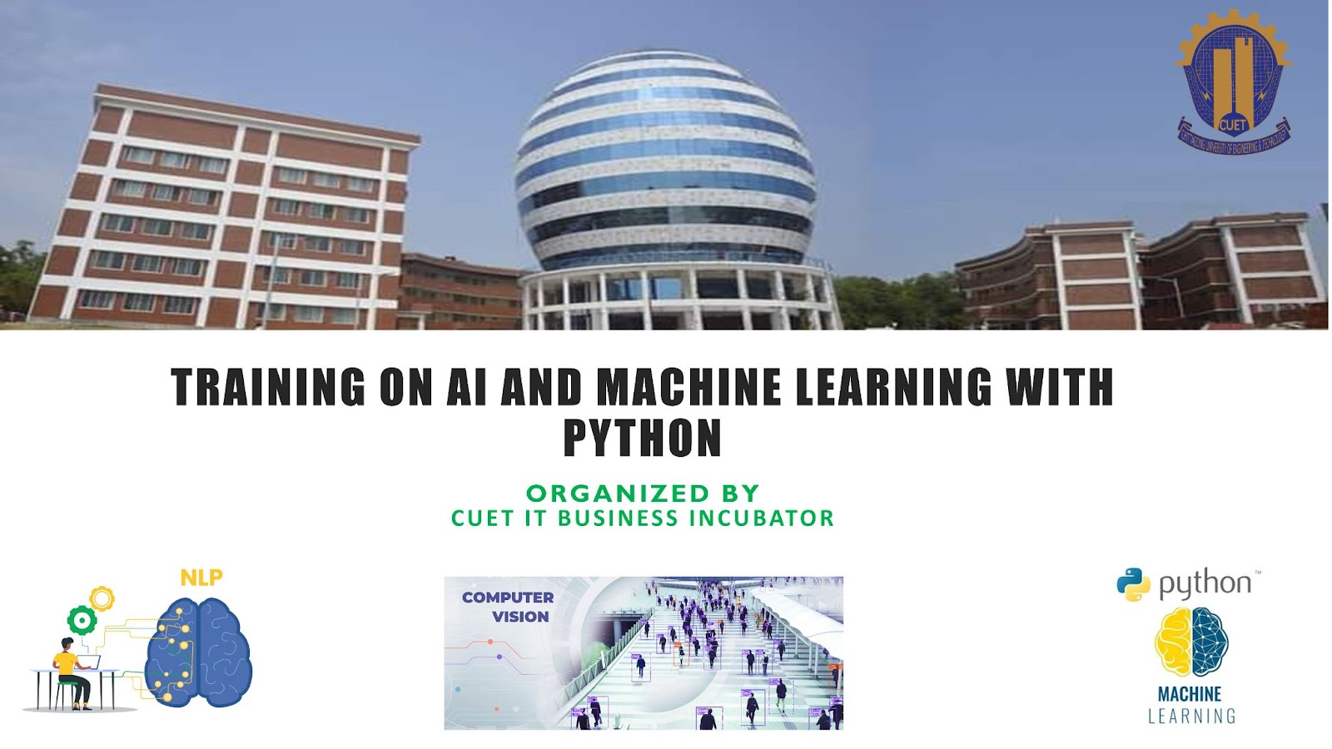
Computer Vision
Dept. of Computer Science & Engineering

Slide 2

Computer Vision
Field of AI that enables computers to derive meaningful information from images, videos, or other visual inputs.

Slide 3
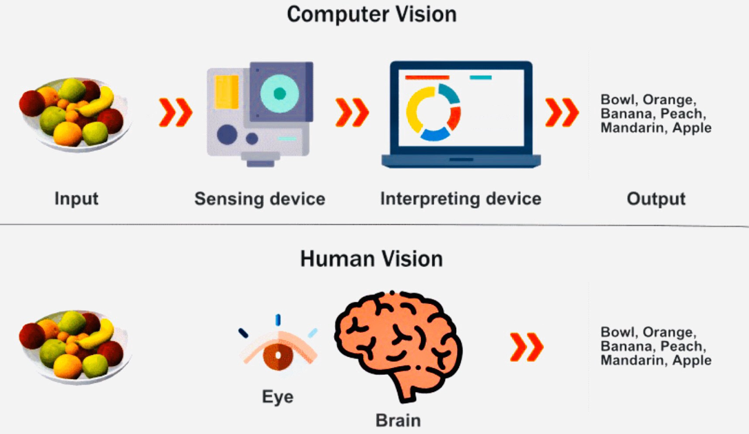
Human Vision vs. Computer Vision
Human vision:
lifetimes of context to train how to tell objects apart, how far away they are, whether they are moving and whether there is something wrong in an image.
Computer vision:
Trains machines to perform these functions. Can analyze thousands of products in less than a minute

Slide 4
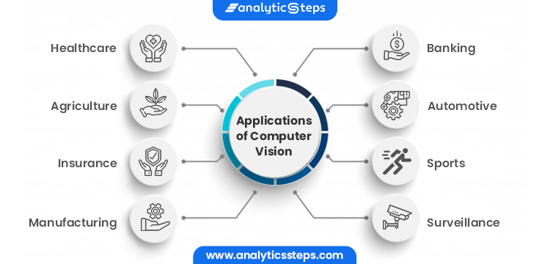
Computer Vision Applications
Tesla: Autonomous cars for hand free driving
Google translate: Convert road signs in one language to another language
Photo scan: Optical Character Recognition (OCR) or QR Code Reader
Facebook: Face recognition for automatic tagging
Boston Dynamics: Designing intelligent robots

Slide 5
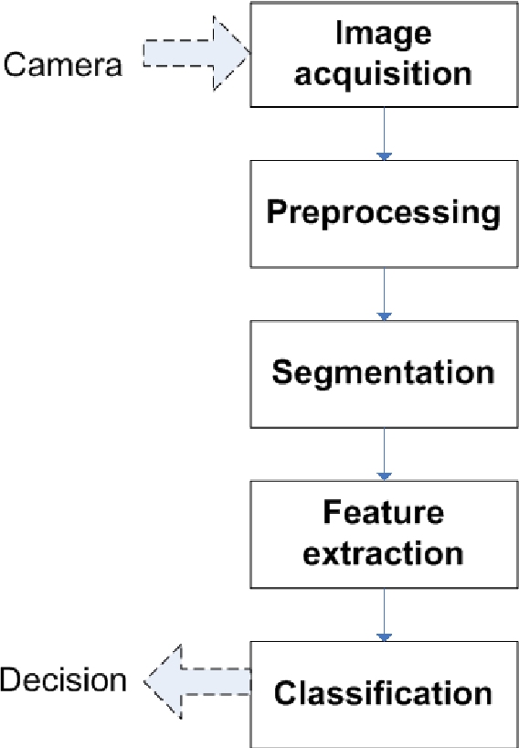
Basic Components of a Image Processing Task

Slide 6
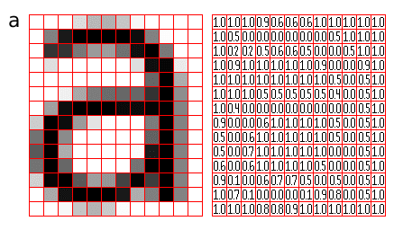
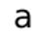
What is an Image?

Slide 7
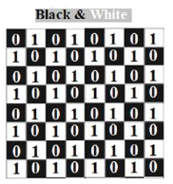
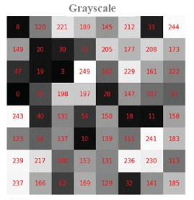
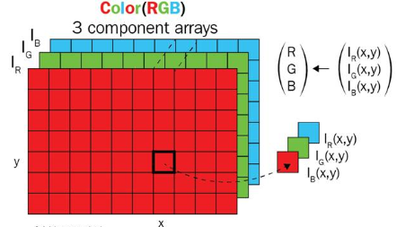
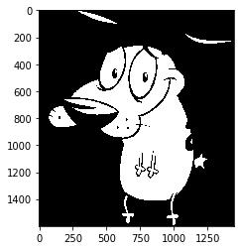
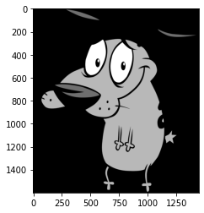
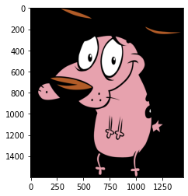
Color Channel
1 channel
1 channel
3 channel

Slide 8
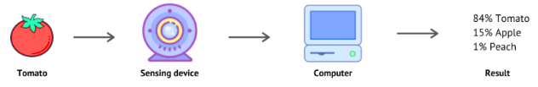
How does computer vision works?
How to solve computer vision tasks?
Computer vision needs lots of data.
It runs analyses of data over and over until it discerns distinctions and ultimately recognize images.
Machine learning based models can enable a computer to teach itself about the context of visual data.
One popular ML algorithm used for computer vision task is convolutional neural network (CNN)

Slide 9

Convolutional Neural Network
Convolutional Neural Networks (CNN) are distinguished from other neural networks by their superior performance with image or visual input signals.
CNN consists of three main layers:
Convolutional layer
Pooling layer
Fully-connected layer

Slide 10
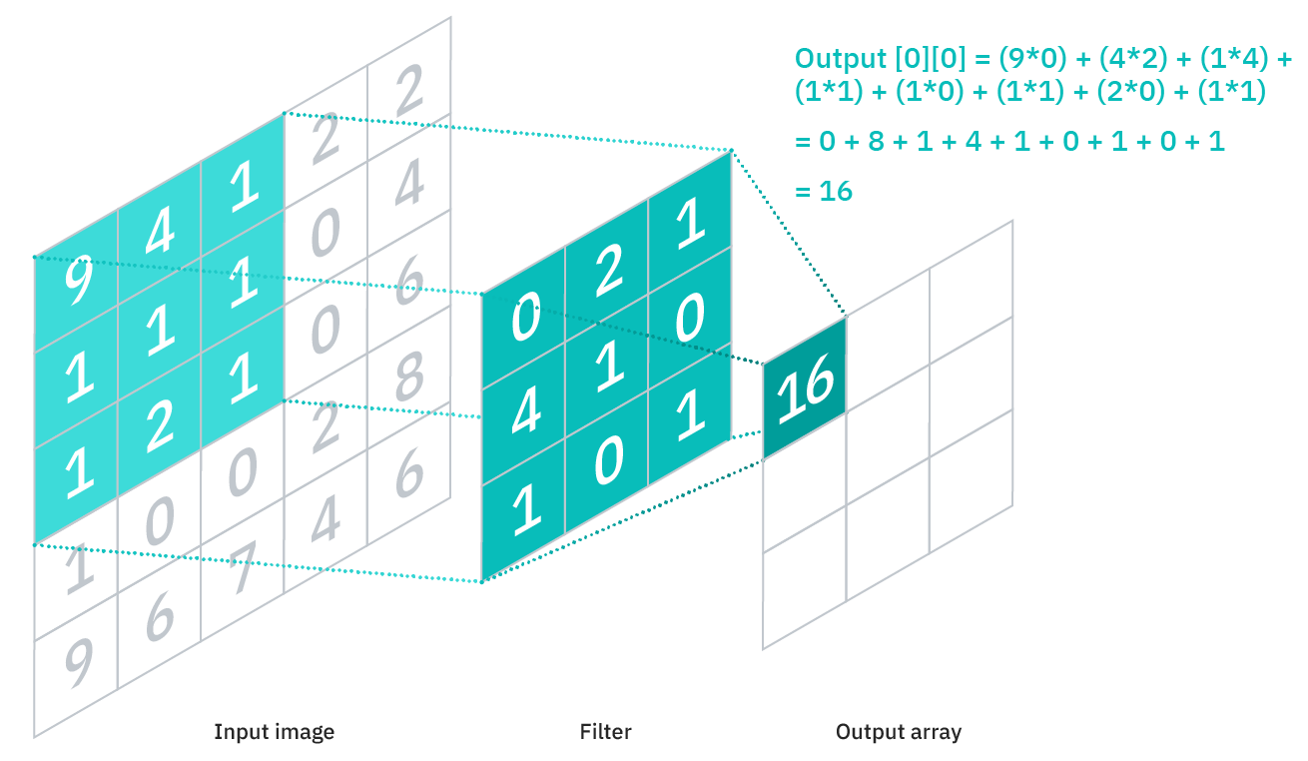
Convolutional Layer
Convolutional Layers are core building block of a CNN.
Focus on detecting edges from an image
It requires a few components, which are input data, a filter, and a feature map.

Slide 11
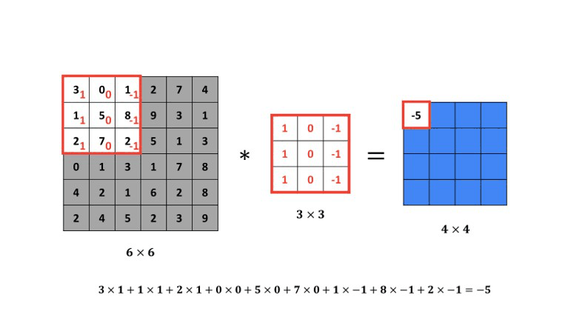
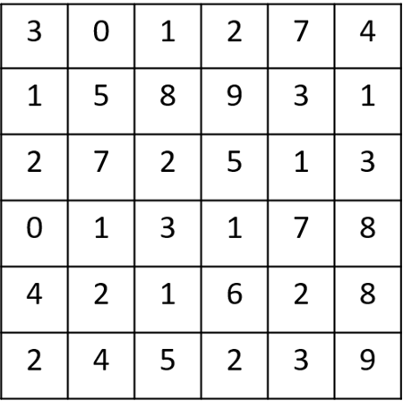
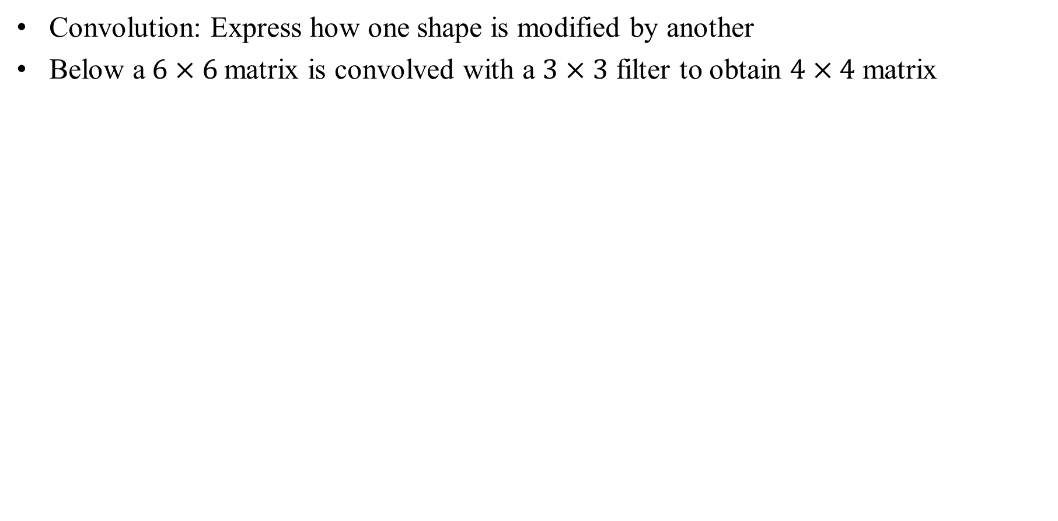
Convolution
Convolution: Express how one shape is modified by another
Below a$6×6$matrix is convolved with a $3×3$ filter to obtain $4×4$ matrix
Input Image

Slide 12
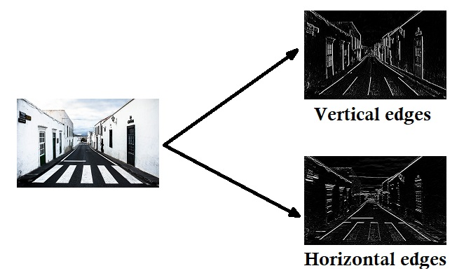
Convolutional Layer (Intuition)
How can we detect these edges from an image?

Slide 13
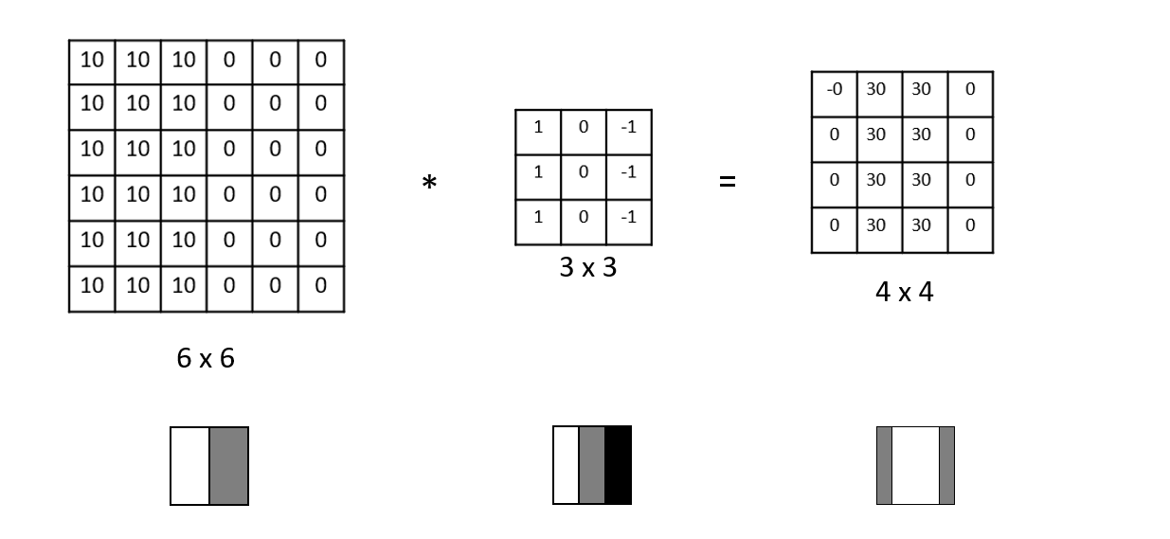
Convolutional Layer (Intuition)
To illustrate this, we use a simplified picture

Slide 14
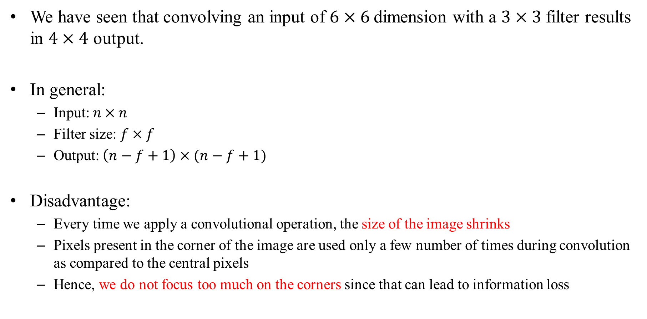
Convolutional Layer
We have seen that convolving an input of $6×6$dimension with a $3×3$ filter results in $4×4$ output.
In general:
Input: $n×n$
Filter size: $f×f$
Output: $\left(n−f+1\right)×(n−f+1)$
Disadvantage:
Every time we apply a convolutional operation, the size of the image shrinks
Pixels present in the corner of the image are used only a few number of times during convolution as compared to the central pixels
Hence, we do not focus too much on the corners since that can lead to information loss

Slide 15
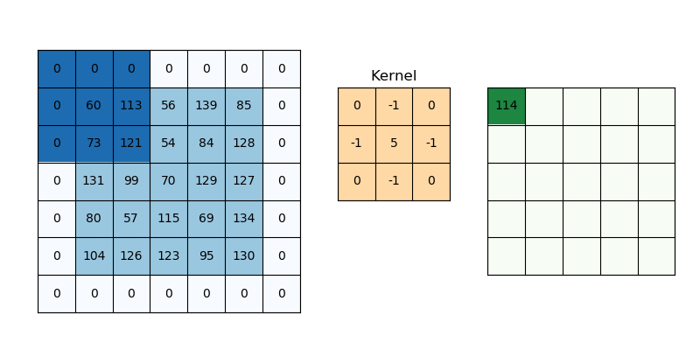
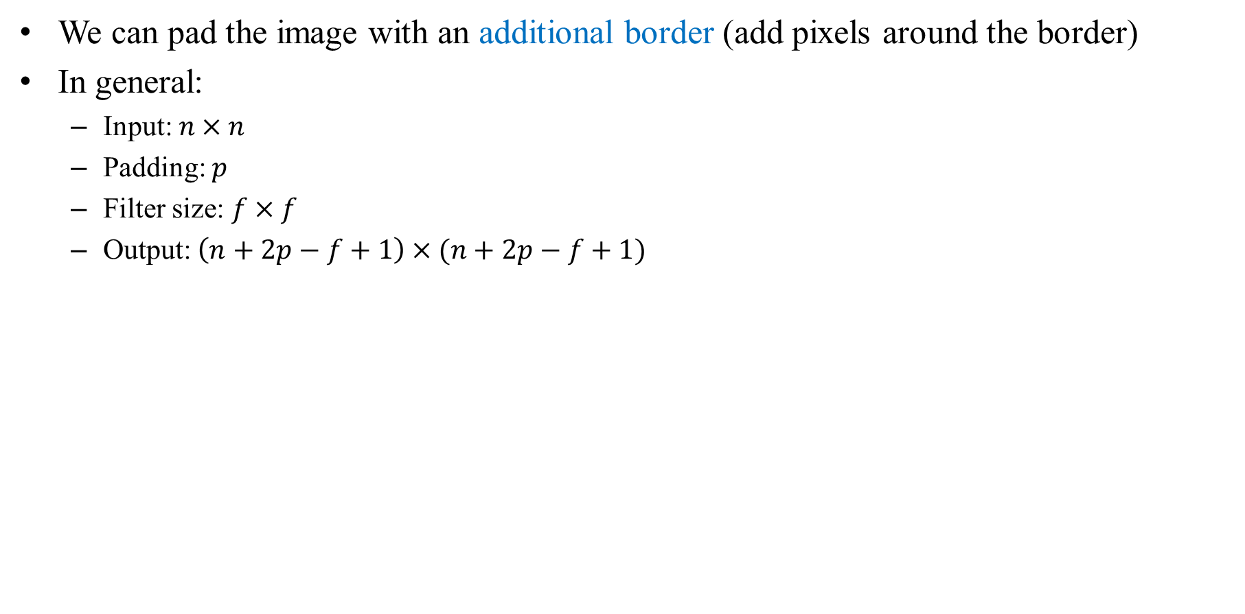
Convolutional Layer (Padding)
We can pad the image with an additional border (add pixels around the border)
In general:
Input: $n×n$
Padding: $p$
Filter size: $f×f$
Output: $\left(n+2p−f+1\right)×(n+2p−f+1)$

Slide 16
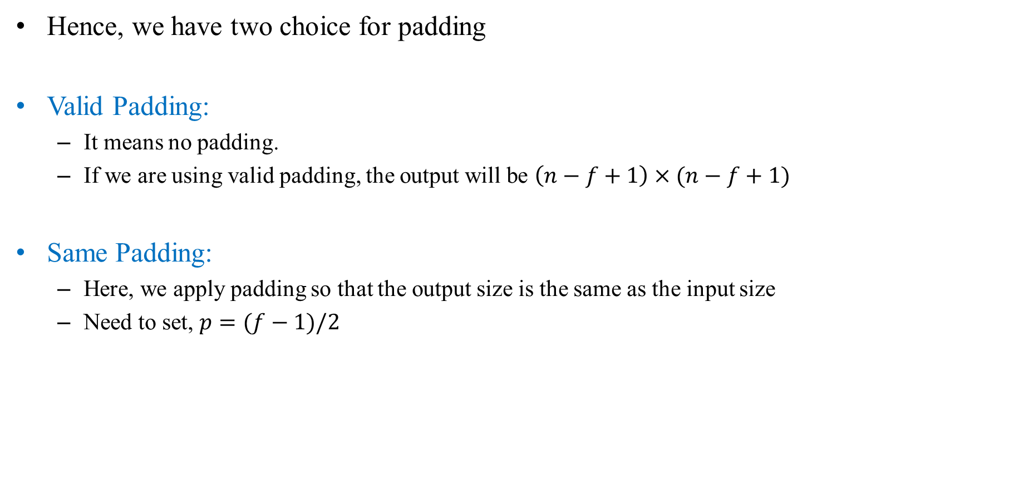
Convolutional Layer (Padding)
Hence, we have two choice for padding
Valid Padding:
It means no padding.
If we are using valid padding, the output will be $\left(n−f+1\right)×(n−f+1)$
Same Padding:
Here, we apply padding so that the output size is the same as the input size
Need to set, $p=(f−1)/2$

Slide 17
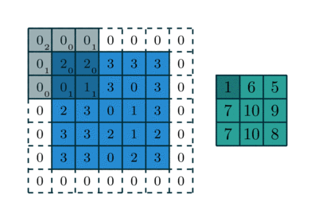
Convolutional Layer (Stride)
Stride is how far the filter moves in every step along one direction.
If we select stride of 2, then we will take two steps – both in the horizontal and vertical directions.

Slide 18
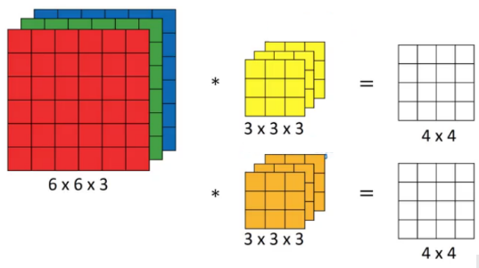
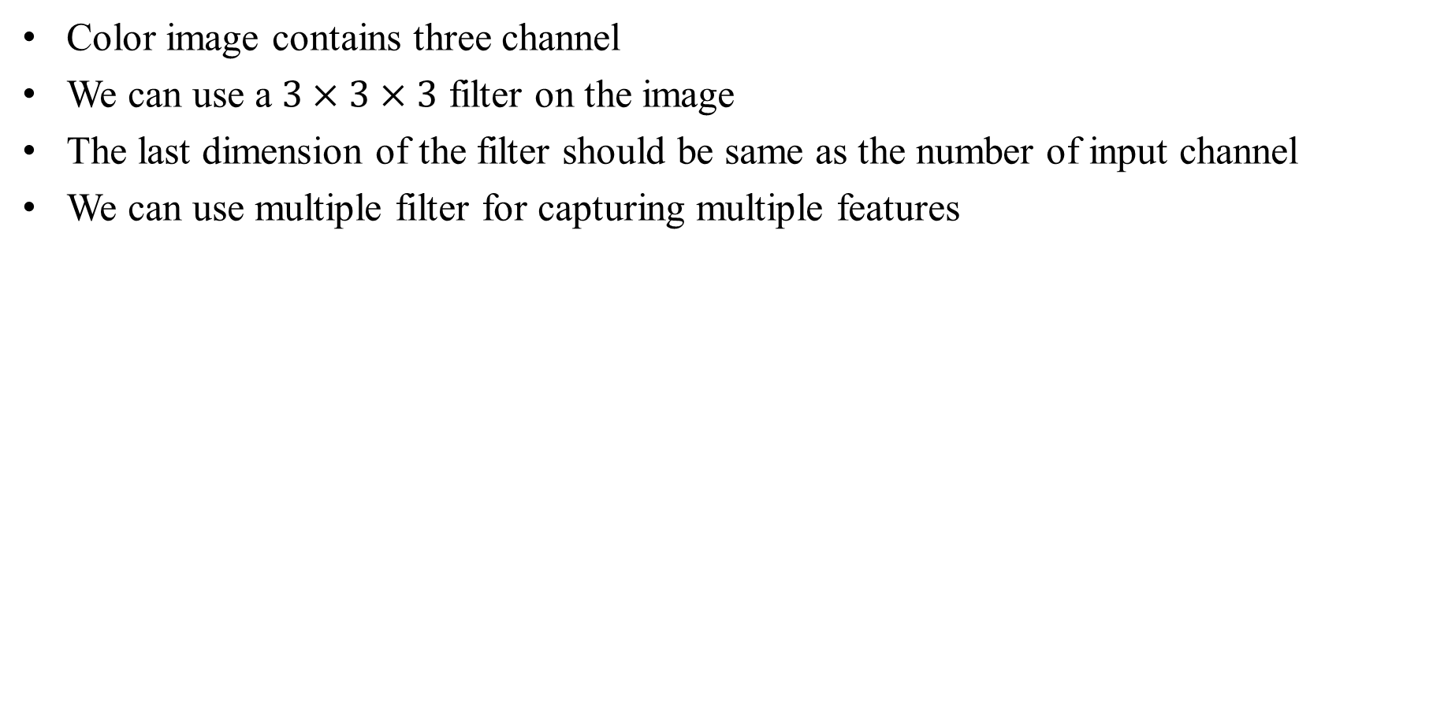
Convolution Over Multiple Channel
Color image contains three channel
We can use a $3×3×3$ filter on the image
The last dimension of the filter should be same as the number of input channel
We can use multiple filter for capturing multiple features

Slide 19
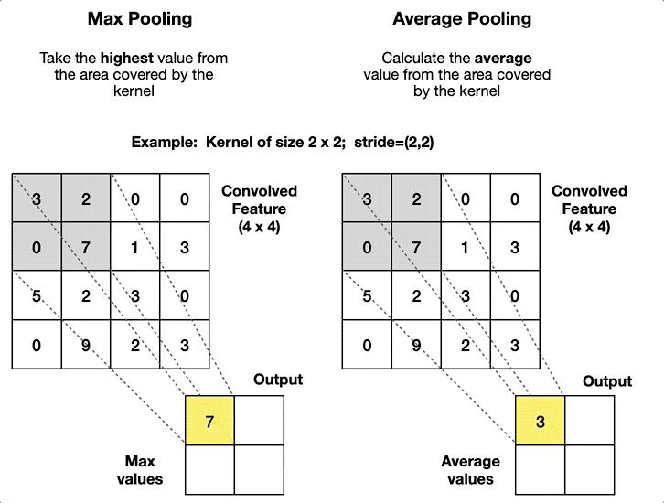
Pooling Layer
Pooling layers are generally used to reduce the size of the inputs and hence speed up the computation.

Slide 20
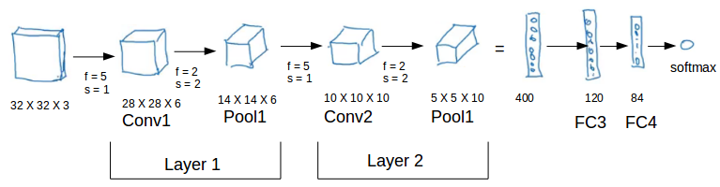
CNN Example
There are a combination of convolution and pooling layers at the beginning
A few fully connected layers at the end
And, finally a softmax classifier to classify the input into various categories
There are a lot of hyperparameters in this network which we have to specify as well

Slide 21
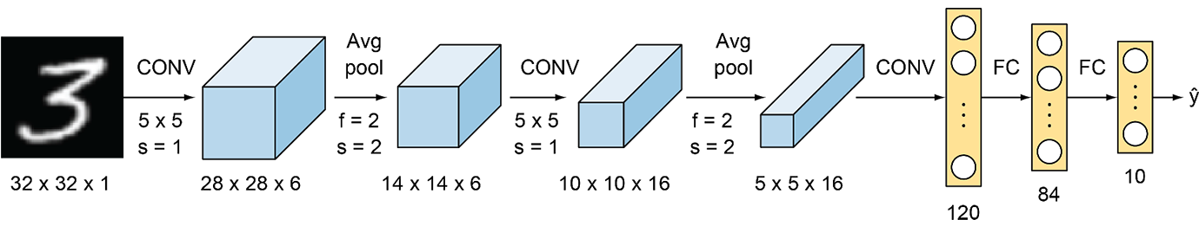
Classical Networks (LeNet-5)
Parameters: 60k
Layers flow: Conv -> Pool -> Conv -> Pool -> FC -> FC -> Output
Activation functions: Sigmoid/tanh and ReLu

Slide 22
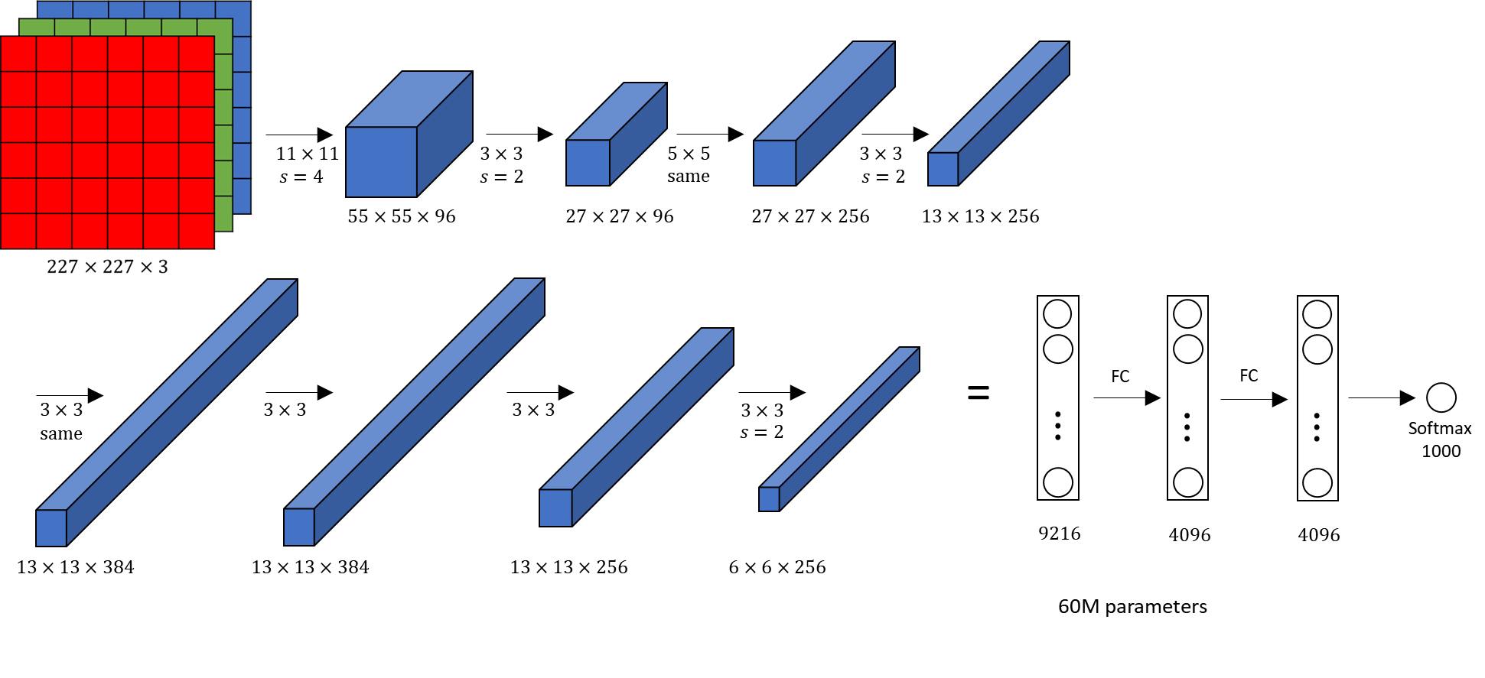
Classical Networks (Alexnet)

Slide 23
More Classical Networks
VGG-16
ResNet
Inception
And many more…

Slide 24
Some Notes
Building your own model from scratch can be a tedious and cumbersome process.
In many cases, we also face issues like lack of data availability.
Steps to follow:
Using Open-Source implementation
Transfer Learning: we can take a pre-trained network and transfer that to a new task which we are working on.
Data Augmentation: Deep learning models perform well when we have a large amount of data.
E.g., Mirroring, Random cropping, Rotating

